Slide 1
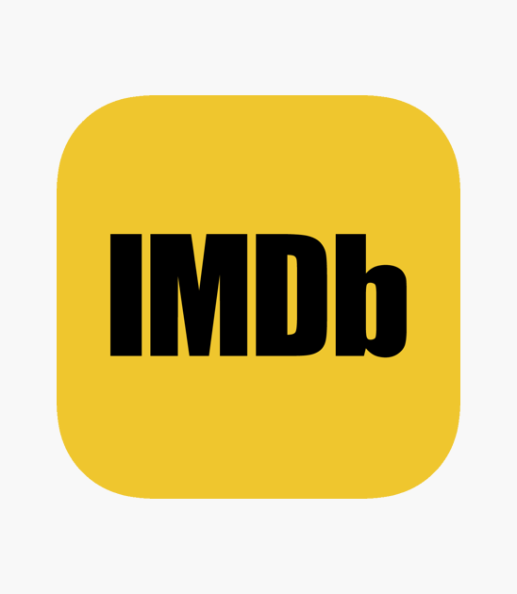
Predicting IMDb Scores: Leveraging Pre-Release Movie Attributes
Jaswanth Kranthi Boppana
Vishnuvardhan Reddy Kollu
Vineela Kunisetti

Slide 2
Problem Statement
IMDb scores are widely regarded as a key indicator of a movie's quality and its reception by audiences and critics. They play a crucial role in shaping viewer expectations and influencing the commercial success of films. Using the IMDb score of a movie before its release is a valuable tool for filmmakers, marketers, and production teams, providing insights into potential audience reception and critical acclaim.
This project aims to leverage pre-release attributes available in the dataset, such as director and actor details, genres, production attributes, and expected audience engagement, to predict a movie's IMDb score. By employing both regression and classification techniques, the project seeks to predict the IMDb score and classify movies into predefined rating categories.

Slide 3
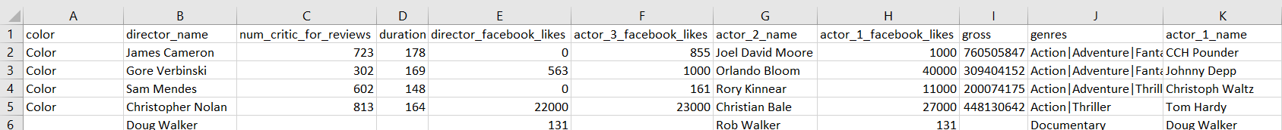
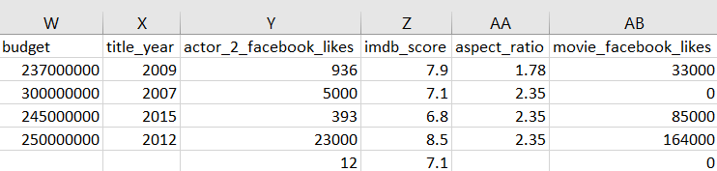
Dataset

Slide 4
Dataset Overview
movie_title: Title of the movie.
duration: Movie duration in minutes.
genres: Movie genres (e.g., Animation, Comedy, Sci-Fi).
plot_keywords: Keywords summarizing the movie's plot.
facenumber_in_poster: Number of actors featured on the movie poster.
director_name: Name of the movie’s director.
budget: Budget allocated for the movie (in US dollars).
country: Country where the movie was produced.
language: Language of the movie (e.g., English, French).
title_year: Year the movie was released (range: 1916–2016).
director_facebook_likes: Number of Facebook likes on the director's page.
actor_1_facebook_likes: Number of Facebook likes for the primary actor.
actor_2_facebook_likes: Number of Facebook likes for the secondary actor.
cast_total_facebook_likes: Total Facebook likes for the entire cast.
actor_3_facebook_likes: Number of Facebook likes for the supporting actor.
movie_facebook_likes: Facebook likes for the movie’s official page.
num_user_for_reviews: Total number of user reviews for the movie.
num_critic_for_reviews: Number of critical reviews listed on IMDb.
num_voted_users: Total number of users who voted for the movie on IMDb.
imdb_score: IMDb rating/score for the movie (range: 0–10).
gross: Gross revenue of the movie (in US dollars)
color: Film colorization type (e.g., Black and White, Color).
content_rating: Age/content rating of the movie (e.g., PG, R).
aspect_ratio: Aspect ratio used in the movie's production.
movie_imdb_link: IMDb link for the movie.

Slide 5

Methods Employed
Data Preprocessing
Feature Engineering
EDA
Classification &
Regression
Handling Missing Values
Outlier Removal
Feature Scaling
Aggregate Metrics
Categorical Encoding
Bubble plot
Scatter plot
Correlation matrix
Random Forest
Gradient Boosting
XGBoost
LightGBM
Linear Regression

Slide 6
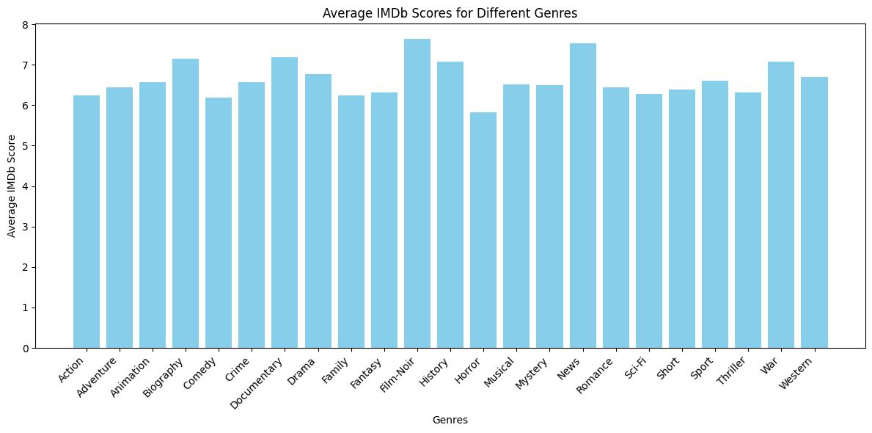
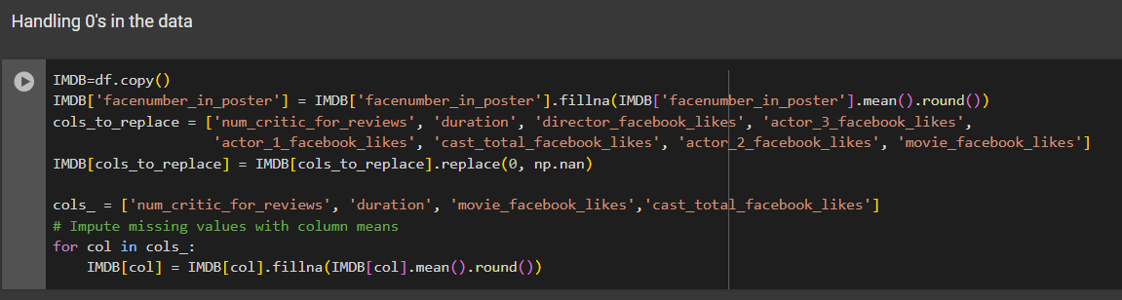
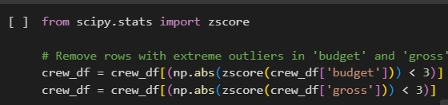
Data Preprocessing:
Removed duplicate rows to ensure there are no repeated entries in the dataset.
Cleaned movie titles by removing unnecessary special characters from the end.
Dropped the genres column as IMDb scores showed minimal variation across genres.
Handled missing values in gross and budget by removing rows with missing data since imputation would be unreliable.
Filled missing values in other columns with their respective column averages for consistency.
Standardized content ratings by replacing outdated ratings (M, GP) with modern equivalents (PG) and (X with NC-17).
Filled missing Facebook likes using the average likes for the respective individual or entity.
Removed irrelevant columns like IMDb links, plot keywords, and movie titles as they added no value to the analysis.
Removed extreme outliers in budget and gross using z-score to ensure data consistency and reduce skewness.

Slide 7
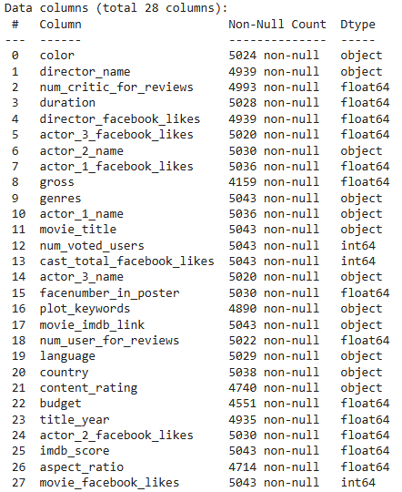
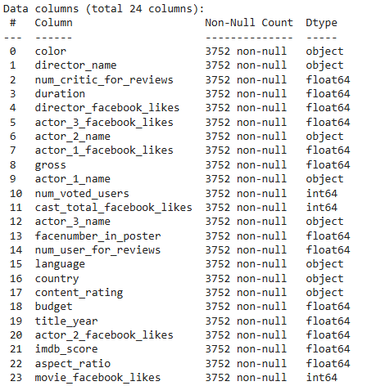
Data Preprocessing:

Slide 8
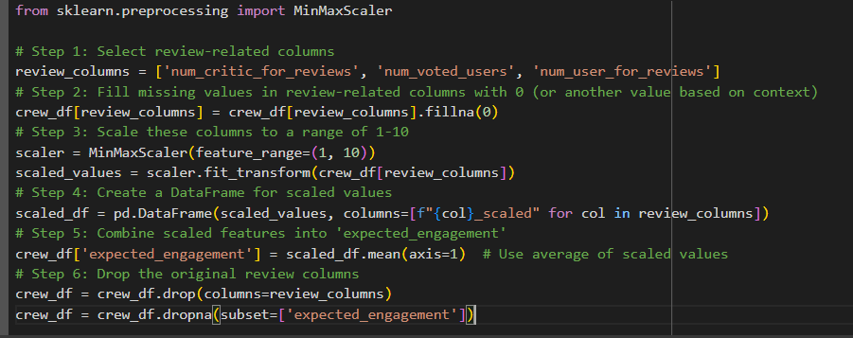
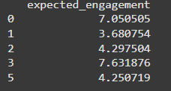
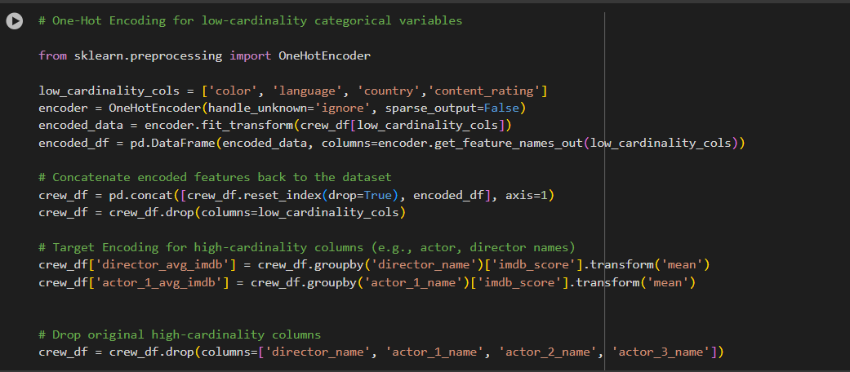
Feature Engineering:
Expected Engagement: Created a new feature, expected_engagement, by scaling and averaging the review-related columns (num_critic_for_reviews, num_voted_users, num_user_for_reviews) to capture audience and critic interaction on a 1-10 scale.
One-Hot Encoding: Transformed low-cardinality categorical variables into numerical features using one-hot encoding.
Target Encoding: Computed average IMDb scores for directors (director_avg_imdb) to reflect historical performance and replaced high-cardinality columns (director_name) with these aggregated values.

Slide 9
Exploratory Data Analysis
Visualization Overview: Commercial Success vs. Critical Acclaim
Purpose:
The plot examines the relationship between IMDb scores, gross earnings, and profitability for the top 20 most profitable movies.
Key Insights:
Movies in the top-right quadrant (e.g., Avatar, The Avengers) exhibit both high IMDb scores and high gross earnings, marking them as critical and commercial successes.
Movies like Jurassic World earned significant revenue despite moderate IMDb scores.
Bubble size indicates profitability, with larger bubbles representing higher profit, and colors represent content ratings (e.g., PG, R).
Additional Highlights:
Reference lines help identify high-grossing movies (above $600M) and high IMDb scores (above 7.75).
Content ratings vary across the dataset, with movies like Titanic and The Lion King spanning diverse audience groups.

Slide 10
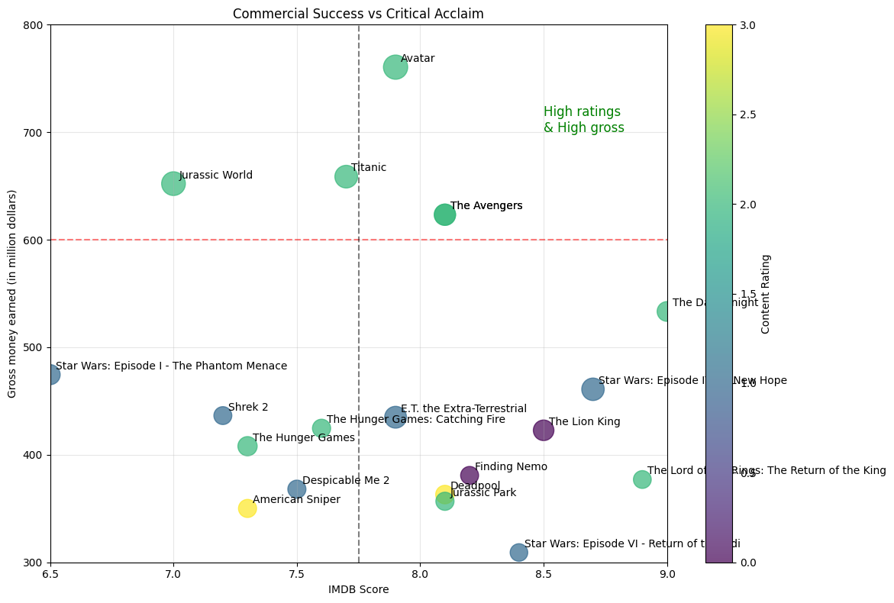
Exploratory Data Analysis

Slide 11
Exploratory Data Analysis
Visualization: IMDb Ratings vs. Facebook Likes by Content Rating
Purpose:
The scatter plot visualizes the relationship between IMDb scores and Facebook likes for movies, categorized by their content rating.
Key Insights:
Movies with higher Facebook likes tend to have higher IMDb scores, indicating a positive correlation between online popularity and critical acclaim.
The majority of movies have fewer than 50,000 Facebook likes, with a few outliers exceeding 200,000 likes.
Content ratings like PG-13 and R dominate the dataset, with varying IMDb scores across Facebook popularity.
Highlights:
The chart uses color coding to differentiate content ratings (e.g., PG, R, NC-17).
Outliers with extremely high Facebook likes are noteworthy but not always associated with the highest IMDb scores.

Slide 12
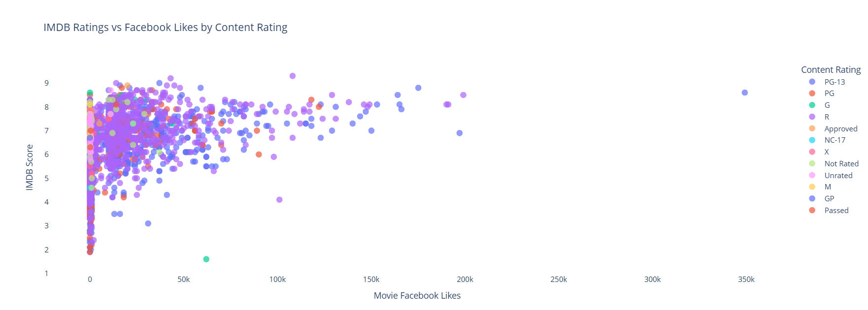
Exploratory Data Analysis

Slide 13
Exploratory Data Analysis
Visualization: Correlation Matrix of IMDb Dataset Features
Purpose:
The heatmap visualizes the correlation between numerical features in the IMDb dataset, helping identify relationships between variables.
Key Insights:
Strong Correlations:
cast_total_facebook_likes is highly correlated with actor_1_facebook_likes (0.94), indicating that the lead actor's popularity heavily influences overall cast popularity.
num_voted_users and gross show a strong positive correlation (0.63), reflecting the relationship between audience engagement and movie earnings.
IMDb Score:
Moderately correlated with num_user_for_reviews (0.39) and gross (0.39), showing the impact of audience engagement and commercial success on ratings.
Outliers:
Budget has a very strong negative correlation with Profit (-0.95), suggesting that higher budgets are associated with lower profits.

Slide 14
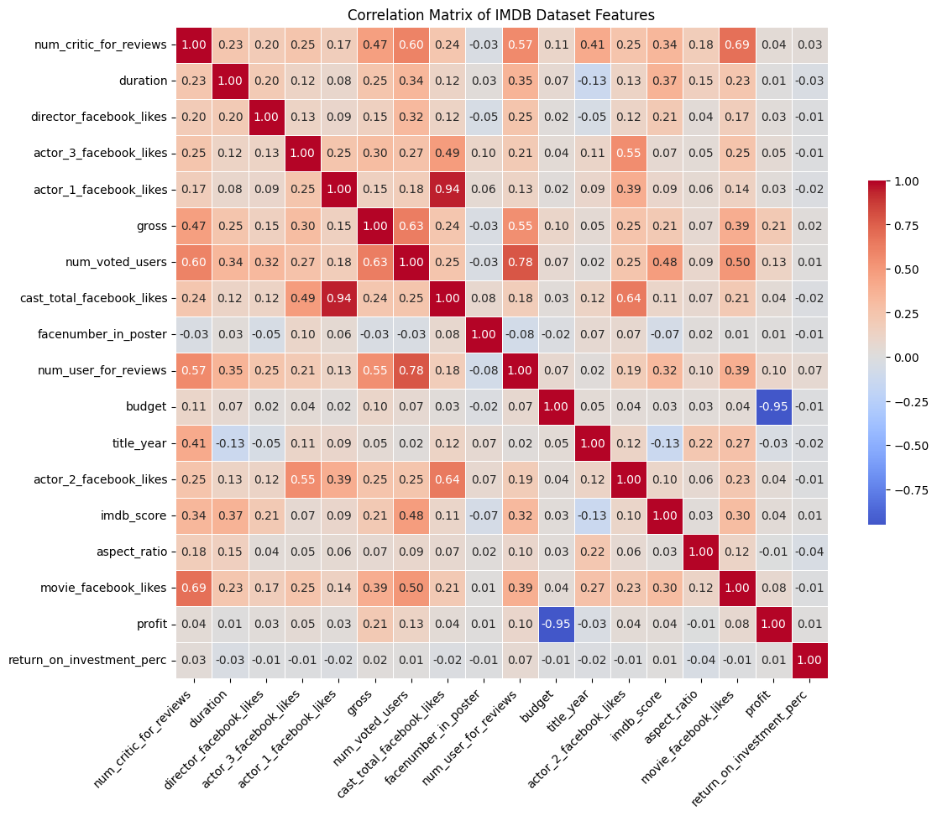
Exploratory Data Analysis

Slide 15
Exploratory Data Analysis
Visualization: Top 20 Profitable Movies
Purpose:
This scatter plot explores the relationship between movie budgets (in million dollars) and profits (in million dollars) for the top 20 most profitable movies released between 2000 and 2016.
Key Insights:
Movies with higher budgets generally yield higher profits, as seen with titles like Avatar, The Avengers, and Jurassic World.
Outliers such as Jurassic World and Avatar stand out with exceptionally high profits, despite their significant budgets.
Mid-budget movies like The Hunger Games and Deadpool demonstrate strong profitability, showing that not all highly profitable movies require large budgets.
Highlights:
The red regression line indicates a positive correlation between budget and profit, with higher budgets typically associated with greater profits.
Annotations highlight individual movie titles, aiding in identifying standout performers.
Movies like The Secret Life of Pets and The Twilight Saga: New Moon show relatively lower profits despite moderate budgets, indicating varying profitability margins.

Slide 16
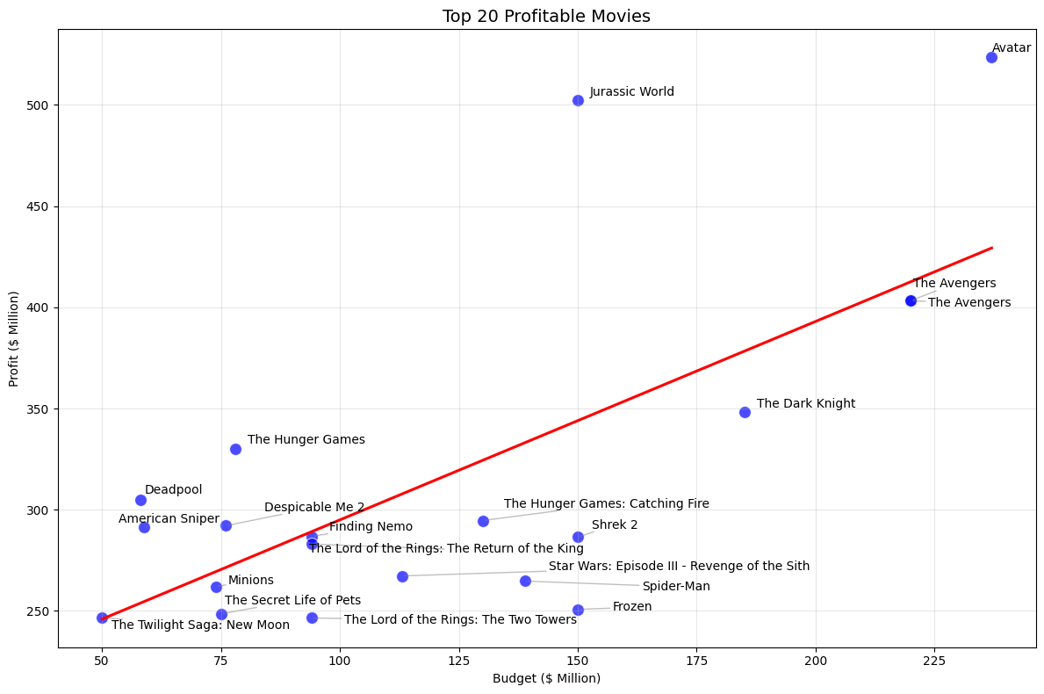
Exploratory Data Analysis

Slide 17
Regression Techniques
LightGBM:
A gradient boosting framework optimized for speed and efficiency, ideal for handling large datasets. It performed well due to its ability to model non-linear relationships in features like Facebook likes and profit.
XGBoost:
XGBoost is a powerful gradient boosting algorithm known for its high performance and efficiency, particularly in handling complex relationships and missing data, making it highly effective for predictive tasks.
Random Forest:
An ensemble method using multiple decision trees. It captured complex interactions among features such as user reviews and gross revenue, though slightly less accurate than boosting models.
Gradient Boosting:
A boosting technique that builds models sequentially to correct previous errors. It performed moderately well, balancing bias and variance, especially for features like Facebook likes.
Linear Regression:
A baseline model assuming a linear relationship between features and the target variable. While simple and interpretable, it underperformed due to the non-linear nature of the data (e.g., budget vs. profit).

Slide 18
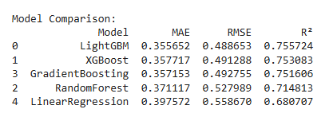
Regression Analysis
LightGBM: The top performer with the lowest MAE (0.355) and RMSE (0.488), and the highest R² (0.755), indicating it accurately captures the variability in IMDb scores.
XGBoost: Comparable to LightGBM, with slightly higher RMSE and lower R², making it another strong candidate.
Gradient Boosting: Achieved results similar to XGBoost, with competitive performance in MAE and RMSE.
Random Forest: Performed moderately well but lagged behind gradient boosting models due to higher RMSE and lower R².
Linear Regression: Struggled with the dataset's non-linear relationships, resulting in higher MAE and RMSE.

Slide 19
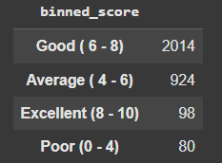
Classification Techniques
To tackle the classification task, we began by addressing the absence of a predefined target variable in the dataset. The numeric scores were segmented into meaningful classes based on specified ranges The distribution of the newly created classes highlighted an imbalance in the dataset:
Mitigating Class Imbalance
To address the class imbalance, we employed stratified sampling to ensure that the proportions of each class were preserved across training and testing datasets.
Model Implementation:
LightGBM: A high-performance gradient boosting algorithm designed for speed and efficiency. Handles large datasets and categorical features effectively. Excels at capturing complex patterns and non-linear relationships, making it ideal for classification tasks like IMDb score categorization.
Random Forest: An ensemble learning method that builds multiple decision trees during training. Combines the predictions of individual trees to improve accuracy and reduce overfitting. Robust to noise and outliers, making it a versatile model for classification problems.
Gradient Boosting: Builds models sequentially, where each new model corrects the errors of the previous one. Optimized for handling imbalanced data and achieving high accuracy by focusing on difficult-to-classify samples. Effective for capturing non-linear relationships and subtle patterns in the dataset.

Slide 20
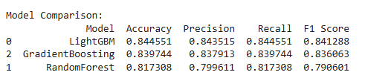
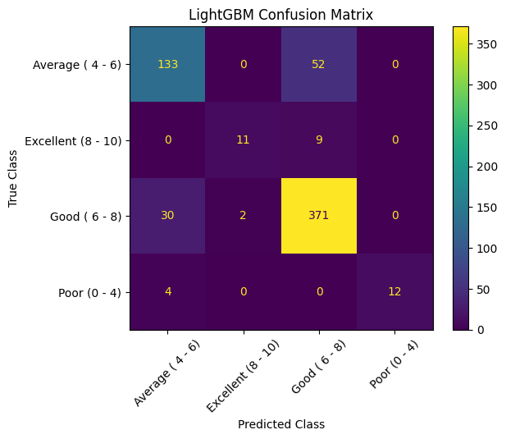
Classification Analysis
LightGBM:
With the highest accuracy (84.5%) and F1 score (0.841), LightGBM captures nuanced relationships between features like budget, user reviews, and Facebook likes.
The balance of precision and recall indicates that the model not only predicts correct categories often but also identifies a majority of the actual instances in each category.
Gradient Boosting:
At 83.9% accuracy and an F1 score of 0.836, Gradient Boosting closely follows LightGBM. It balances misclassifications effectively across categories, making it a reliable alternative.
Its slight dip in recall compared to LightGBM suggests that it occasionally misses some true positives, particularly in ambiguous boundary cases.
Random Forest:
With an accuracy of 81.7% and an F1 score of 0.799, Random Forest is less effective than boosting models for this task.
It struggles with mid-range categories like "Good" (6-8), where feature overlap makes classification more challenging.
However, its performance in extreme categories ("Poor" and "Excellent") shows its strength in capturing simpler distinctions.

Slide 21
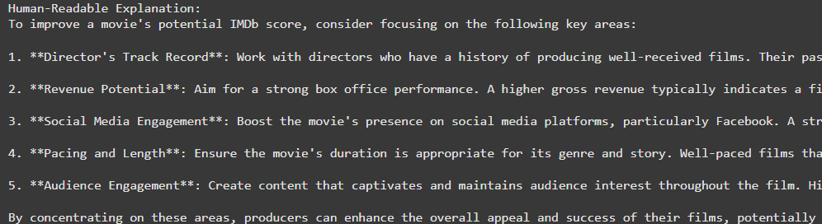
Extracting Feature Importance and Integrating GPT API
Once the classification and regression models are evaluated based on their respective performance metrics, the best-performing model is selected for further analysis.
The selected model's feature importance metrics are extracted to provide insights into the key factors influencing the predictions.
These feature importance values, along with the predicted IMDb scores, are used as input for a GPT model. This integrates the OpenAI API to automatically generate human-readable explanations, offering intuitive analogies and actionable insights.
The project workflow includes automating the OpenAI API prompts with relevant inputs, such as feature importance and predicted scores for a specific example.
This enables users to better understand the underlying drivers of the model's performance and identify potential adjustments or critical metrics to optimize results effectively.

Slide 22
Future Scope
Incorporating Additional Features
Expanding Target Variables
Cross-Domain Applications
Longitudinal Analysis
Integrate more pre-release attributes such as trailer views, social media engagement trends, and media coverage sentiment to enhance prediction accuracy.
Predict other key movie metrics such as opening weekend box office revenue, lifetime gross earnings, or return on investment (ROI).
Adapt the model for predicting success metrics in TV shows, web series, or video games, broadening its applicability in the entertainment industry.
Extend the model to predict trends over time, analyzing how a director's or actor's performance impacts movie success across multiple projects.

Slide 23
Thank You

